Slide 1
Machine Learning Frameworks

Slide 2



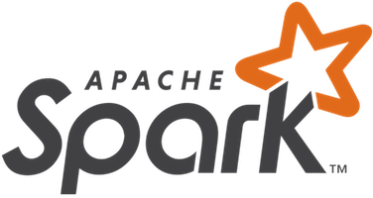
Popular Machine Learning Frameworks
scikit learn http://scikit-learn.org/stable/
TensorFlow https://www.tensorflow.org/
Cognitive Toolkit https://www.microsoft.com/en-us/cognitive-toolkit/
Spark ML https://spark.apache.org/mllib/

Slide 3
scikit learn
Simple and efficient tools for data mining and data analysis
Accessible to everybody, and reusable in various contexts
Built on NumPy, SciPy, and matplotlib
Open source, commercially usable - BSD license
Hundreds of examples written in Python Language
or as Jupyter Notebooks

Slide 4
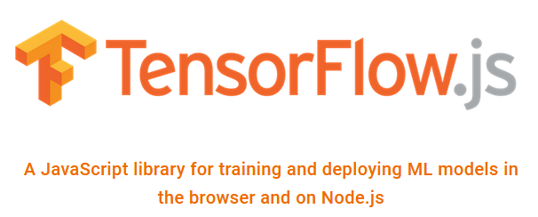
TensorFlow
open source software library
for high performance numerical computation
easy deployment of computation across a variety of platforms
Originally developed by researchers and engineers from the Google Brain team within Google’s AI organization
strong support for machine learning and deep learning
Support for Python, Javascript and Node.js

Slide 5
TensorFlow
Description
https://de.m.wikipedia.org/wiki/TensorFlow
Crash Course
https://developers.google.com/machine-learning/crash-course/first-steps-with-tensorflow/toolkit
Lots of Tutorials
https://js.tensorflow.org/tutorials/

Slide 6
Cognitive Toolkit
Home Page:
https://www.microsoft.com/en-us/cognitive-toolkit/
Features:
https://www.microsoft.com/en-us/cognitive-toolkit/features/
Tutorials:
https://cntk.ai/pythondocs/tutorials.html

Slide 7
Cognitive Toolkit
deep learning
by providing uncompromised scaling, speed, and accuracy
with commercial-grade quality and compatibility with the programming languages and algorithms you already use.
Skype, Cortana, Bing, Xbox, and industry-leading data scientists already use the Microsoft Cognitive Toolkit to develop commercial-grade AI.
Programming Languages: C++ and Python

Slide 8
Spark ML
Apache Spark is a fast and general-purpose cluster computing system.
high-level APIs in Java, Scala and Python and R, and an optimized engine that supports general execution graphs.
rich set of higher-level tools including Spark SQL for SQL and structured data processing,
MLlib for machine learning,
GraphX for graph processing, and Spark Streaming.
https://spark.apache.org/docs/1.2.2/index.html

Slide 9
Caffe
http://caffe.berkeleyvision.org/
Caffe is a deep learning framework made with expression, speed, and modularity in mind. It is developed by Berkeley AI Research (BAIR) an
Expressive architecture encourages application and innovation.
Extensible code fosters active development. In Caffe’s first year, it has been forked by over 1,000 developers and had many significant changes contributed back.
Speed makes Caffe perfect for research experiments and industry deployment. Caffe can process over 60M images per day with a single NVIDIA K40 GPU*. That’s 1 ms/image for inference and 4 ms/image for learning and more recent library versions and hardware are faster still

